Slide 1
RED-BLACK TREES
Kalangi sathvika
20010048

Slide 2
Red-black trees are a type of self-balancing binary search tree that ensure that the height of the tree is always balanced.
few key reasons why red-black trees are useful:
Faster search: Red-black trees provide guaranteed logarithmic time complexity for search, insertion, and deletion operations. This makes them very efficient for use in data structures where fast access and modification times are important.
Balanced structure: Unlike other types of binary search trees, red-black trees are guaranteed to be balanced, which means that the height of the tree is always O(log n), where n is the number of nodes in the tree. This helps to ensure that operations such as insertion and deletion are performed quickly and with minimal disruption to the overall structure of the tree.
Reliability: The self-balancing property of red-black trees ensures that they are always well-formed, which makes them less prone to errors and bugs than other types of binary search trees.
Versatility: Red-black trees can be used to implement a wide variety of data structures, including sets, maps, and associative arrays. They are also often used in the implementation of algorithms such as interval trees, which require a balanced data structure to function efficiently.

Slide 3
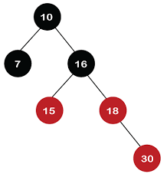
Every red-black tree must follow the following rules:
Every node is either red or black.
The root node is black.
Every leaf node (NIL) is black.
If a node is red, then its children must be black.
Every path from a node to its descendant NIL nodes must contain the same number of black nodes (this is called the "black-height" property).
These rules ensure that the red-black tree is balanced.
Example:

Slide 4
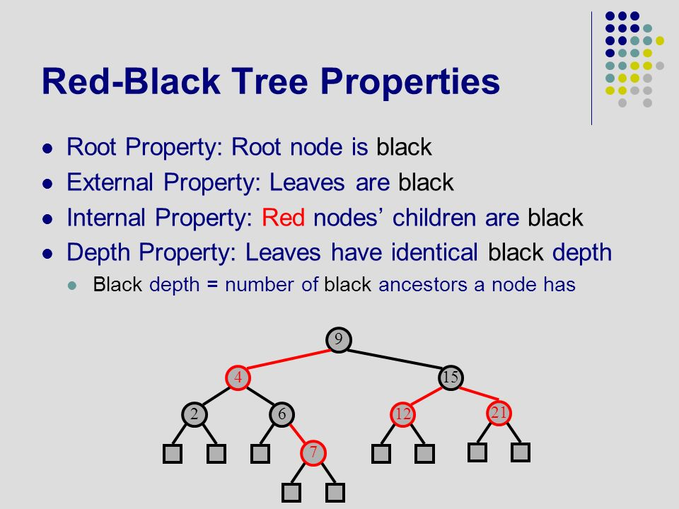
Properties of Red Black Trees:
If a Red Black Tree is complete, with all Black nodes except for Red leaves at the lowest level the height will be minimal, ~log N
To get the max height for N elements there should be as many Red nodes as possible down one path and all other nodes are Black
-This means the max height would be < 2 * log N
The black height of the red-black tree is the number of black nodes on a path from the root node to a leaf node. Leaf nodes are also counted as black nodes. So, a red-black tree of height h has black height >= h/2.

Slide 5
Insertion of a node in Red Black Tree:
To add an element to a Red Black Tree, we must follow this algorithm:
1) Check whether tree is Empty.
2) If tree is Empty then insert the newNode as Root node with color Black and exit from the operation.
3) If tree is not Empty then insert the newNode as a leaf node with Red color.
4) If the parent of newNode is Black then exit from the operation.
5) If the parent of newNode is Red then check the color of parent node's sibling of newNode.
6) If it is Black or NULL node then make a suitable Rotation and Recolor it.
7) If it is Red colored node then perform Recolor and Recheck it. Repeat the same until tree becomes Red Black Tree.
Complexity:
Average and Worst case insertion time complexity: Θ(log n)
Average and Worst case Space complexity: Θ(n)
Implementation: https://www.geeksforgeeks.org/insertion-in-red-black-tree/

Slide 6
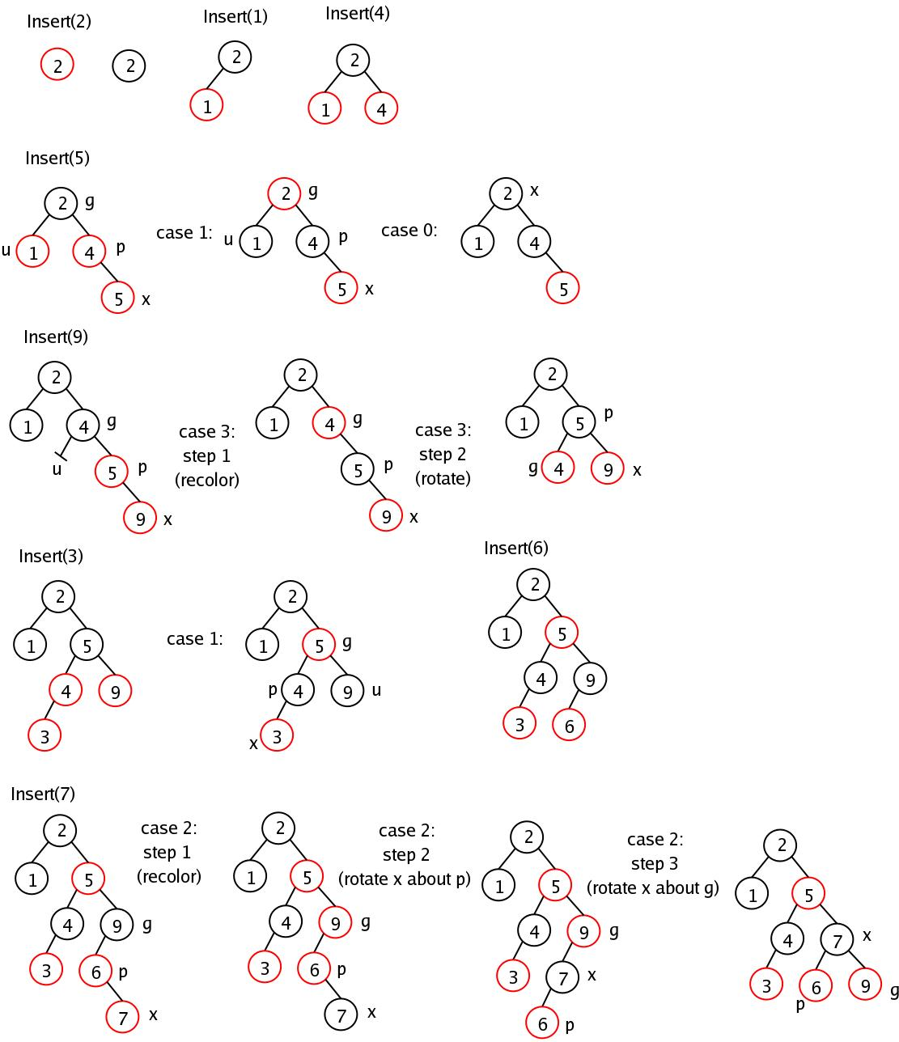

Slide 7
Deletion of a node in Red Black Tree:
1) Perform standard Binary Search Tree delete. When we perform standard delete operation in BST, we always end up deleting a node which is either leaf or has only one child (For an internal node, we copy the successor and then recursively call delete for successor, successor is always a leaf node or a node with one child). So we only need to handle cases where a node is leaf or has one child. Let v be the node to be deleted and u be the child that replaces v (Note that u is NULL when v is a leaf and color of NULL is considered as Black).
2) Simple Case: If either u or v is red, we mark the replaced child as black (No change in black height). Note that both u and v cannot be red as v is parent of u and two consecutive reds are not allowed in red-black tree.
3) If Both u and v are Black. 3.1) Color u as double black. Now our task reduces to convert this double black to single black. Note that If v is leaf, then u is NULL and color of NULL is considered as black. So the deletion of a black leaf also causes a double black.
←

Slide 8
3.2) Do following while the current node u is double black and it is not root. Let sibling of node be s. (a): If sibling s is black and at least one of sibling’s children is red, perform rotation(s). Let the red child of s be r. This case can be divided in four subcases depending upon positions of s and r.
(i) Left Left Case (s is left child of its parent and r is left child of s or both children of s are red). This is mirror of right right case shown in below diagram.
(ii) Left Right Case (s is left child of its parent and r is right child). This is mirror of right left case shown in below diagram.
(iii) Right Right Case (s is right child of its parent and r is right child of s or both children of s are red)
(iv) Right Left Case (s is right child of its parent and r is left child of s)
(b): If sibling is black and its both children are black, perform recoloring, and recur for the parent if parent is black.
(c): If sibling is red, perform a rotation to move old sibling up, recolor the old sibling and parent. The new sibling is always black (See the below diagram). This mainly converts the tree to black sibling case (by rotation) and leads to case (a) or (b). This case can be divided in two subcases. (i) Left Case (s is left child of its parent). This is mirror of right right case shown in below diagram. We right rotate the parent p. (ii) Right Case (s is right child of its parent). We left rotate the parent p.
3.3) If u is root, make it single black and return (Black height of complete tree reduces by 1).

Slide 9
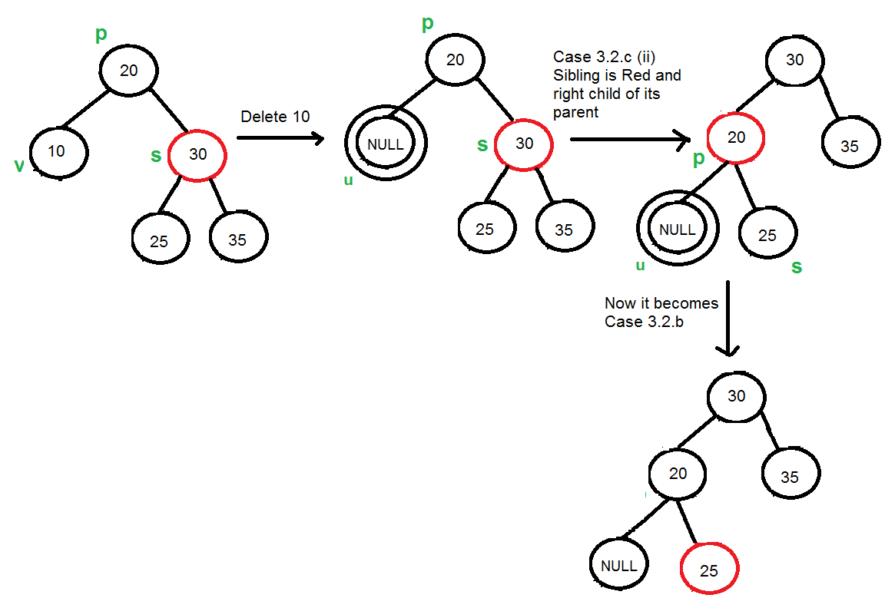
Complexity:
Average and Worst case deletion time complexity: Θ(log n)
Average and Worst case Space complexity: Θ(n)

Slide 10
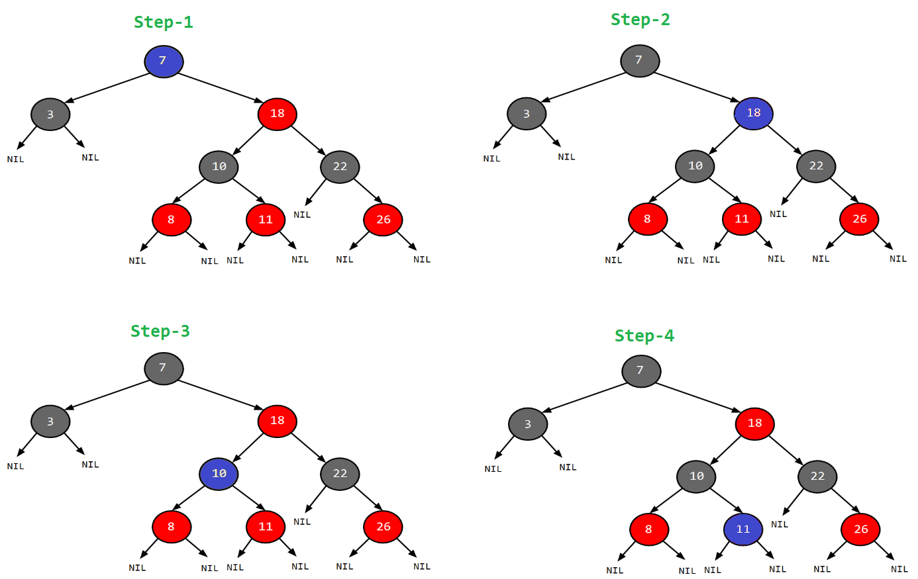
Searching a node in Red Black Tree:
Start from the root.
Compare the inserting element with root, if less than root, then recurse for left, else recurse for right.
If the element to search is found anywhere, return true, else return false.
Ex: Search 11.
Step-1: 11>root(7).
Check right.
Step-2: 11<18.
Check left of 18.
Step-3: 11>10.
Check right of 10.
Step-4: 11=11.
11 found.

Slide 11
Complexity:
Average and Worst case search time complexity: Θ(log n)
Average and Worst case Space complexity: Θ(n)
Disadvantages:
Red Black Trees have many applications in different fields, but they still have some disadvantages, they are as follows.
Red Black Trees require one extra bit of storage for each node to store the color of the node (red or black).
Complexity of Implementation.
Although Red Black Trees provide efficient performance for basic operations, they may not be the best choice for certain types of data or specific use cases.

Slide 12
THANK YOU

